Slide 1
Quiz on humanaiclass.org
User Trust and failure cases

Slide 2
Today’s topics
Review: False positives, false negatives, acceptable failure and not acceptable failure for the user
How do developers discover a ML mistakes that are happening to users?
How will users react to with ML mistakes?
Using user feedback to improve performance
Implicit feedback from the user
Explicit feedback from the user
Preserving user trust in the face of mistakes
Discussion

Slide 3
Review: what are the stakes for ML failure?
User: high stakes
AI/ML causes active harm (e.g. recidivism prediction or hiring prediction)
AI/ML reveals information someone wanted kept private
AI/ML shows offensive content
User: low stakes
AI/ML feature is annoying or interrupting
AI/ML feature is often wrong
AI/ML feature is useless
Product/Service organization:
Users stop using your app/service because of poor AI/ML performance
Bad press or legal troubles
Bad reviews discouraging others from using the app/service

Slide 4
Review: what do ML failures or limitations look like
During Development
Insufficient data
Poor model accuracy
ML task is more expensive than it’s worth
User scenarios not sufficiently mapped
What to do
Start with scenarios (designers + product managers + engineers)
Start with de-risking
Purposefully design (quantitative) metrics to match scenarios and user studies (qualitative)
Deployed out in the Wild
ML features fails silently (unkown unkown)
ML feature reduces or does not add engagement
What to do
Design performance metrics for deployment around engagement, use, accuracy
Collect (private and appropriate) user data
If possible, do a field study with a special group of beta users

Slide 5
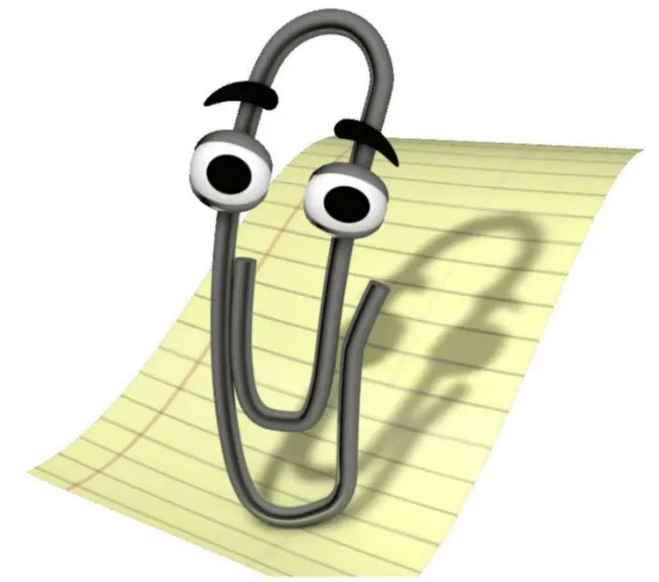
User tolerance for failure in AI/ML features

Slide 6
User tolerance for failure in AI/ML features
What is the role of the AI/ML feature?
Critical / Complementary
Proactive / Reactive
Visible / Invisible

Slide 7
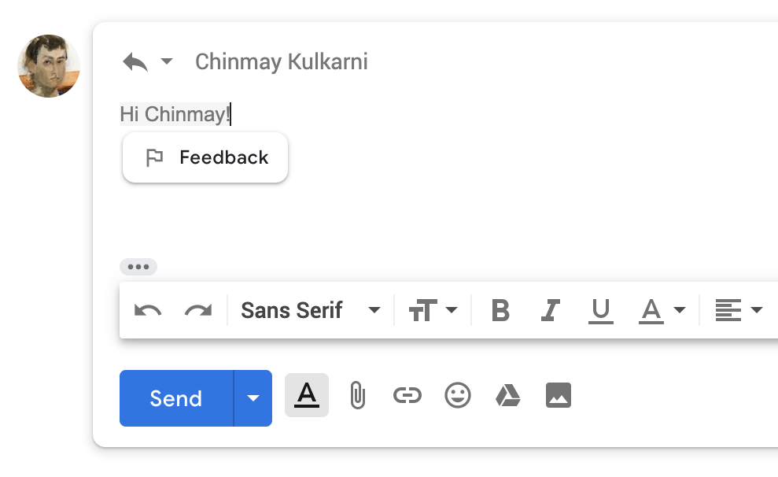
User tolerance for failure in AI/ML features
Proactive features in small amounts can be helpful.
Must be easy to dismiss
Proactive features that actively suggest content or do something for the user have more potential to be annoying.
Notes:
https://developer.apple.com/design/human-interface-guidelines/machine-learning/overview/roles/

Slide 8
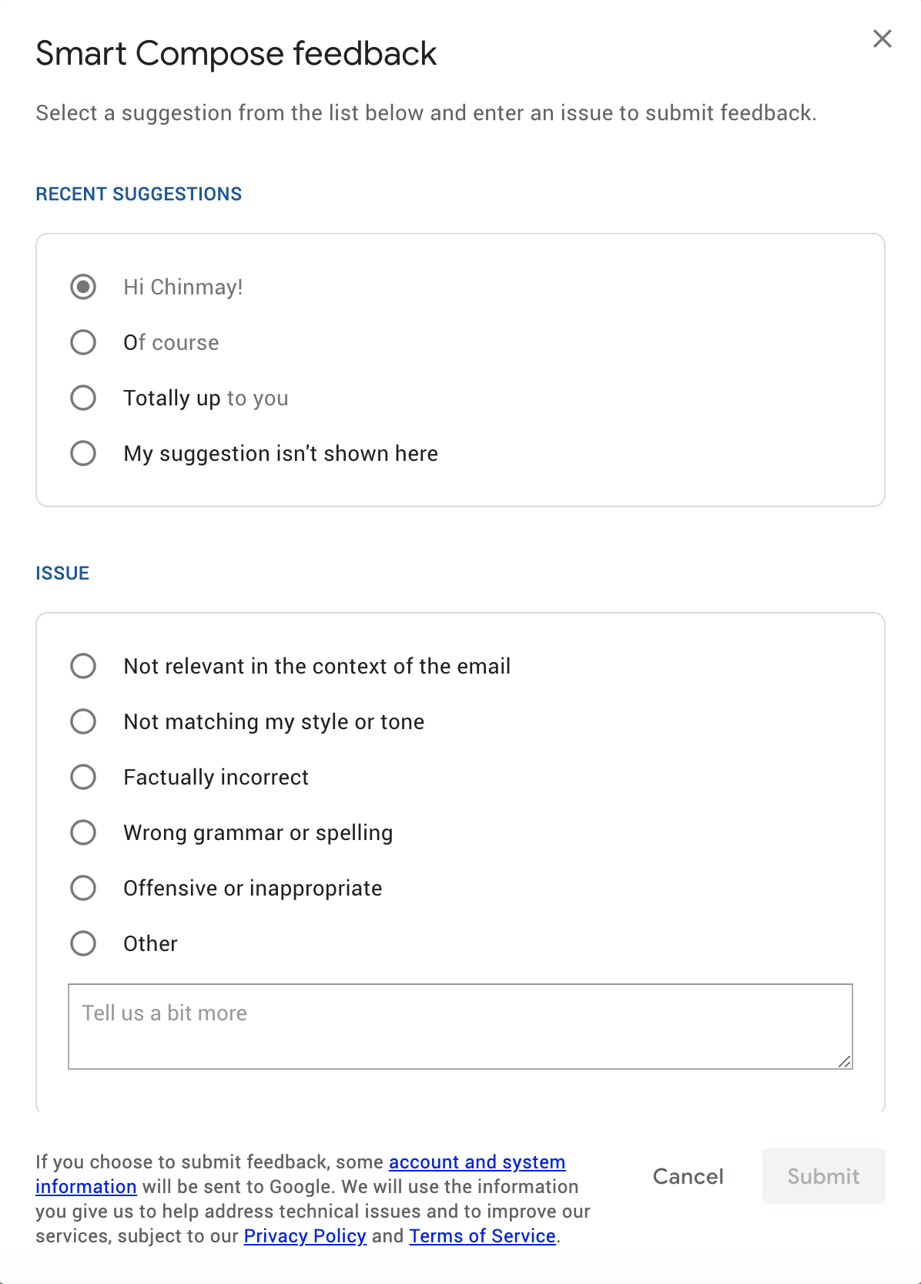
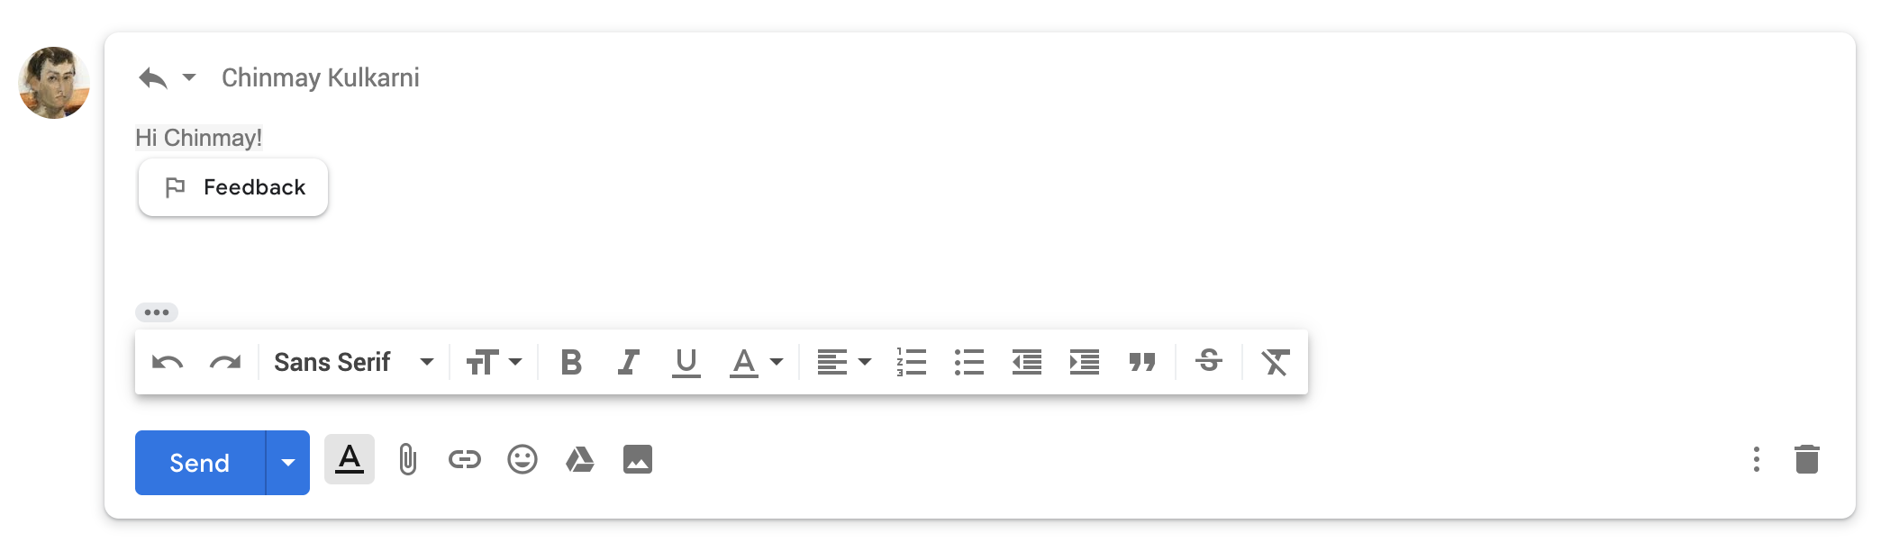
User tolerance for giving feedback
Don’t overuse or users will get annoyed
Users won’t like to feel like the AI is so stupid it needs their help
Save for high stakes failure is possible
Google smart compose feedback form 9/19
Notes:
https://developer.apple.com/design/human-interface-guidelines/machine-learning/overview/roles/

Slide 9
User tolerance for failure in AI/ML features
What is the role of the AI/ML feature?
Critical / Complementary
Proactive / Reactive
Visible / Invisible
How might a user react to failure?
How should the system best react to failure to not lose the user’s trust?
Invisible + Critical (e.g. smart home)
Proactive AI/ML behavior
Reacting to a request
Visible + Complementary + Proactive (e.g. Youtube recommendation)
Visible + Critical + Reactive (e.g. a smart search)
Notes:
https://developer.apple.com/design/human-interface-guidelines/machine-learning/overview/roles/

Slide 10
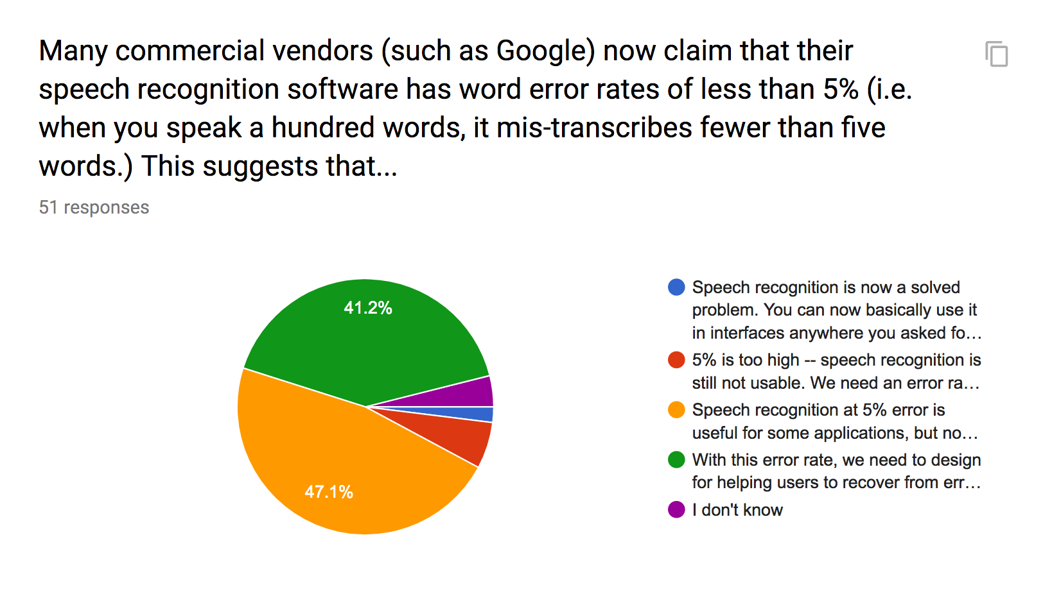

Slide 11
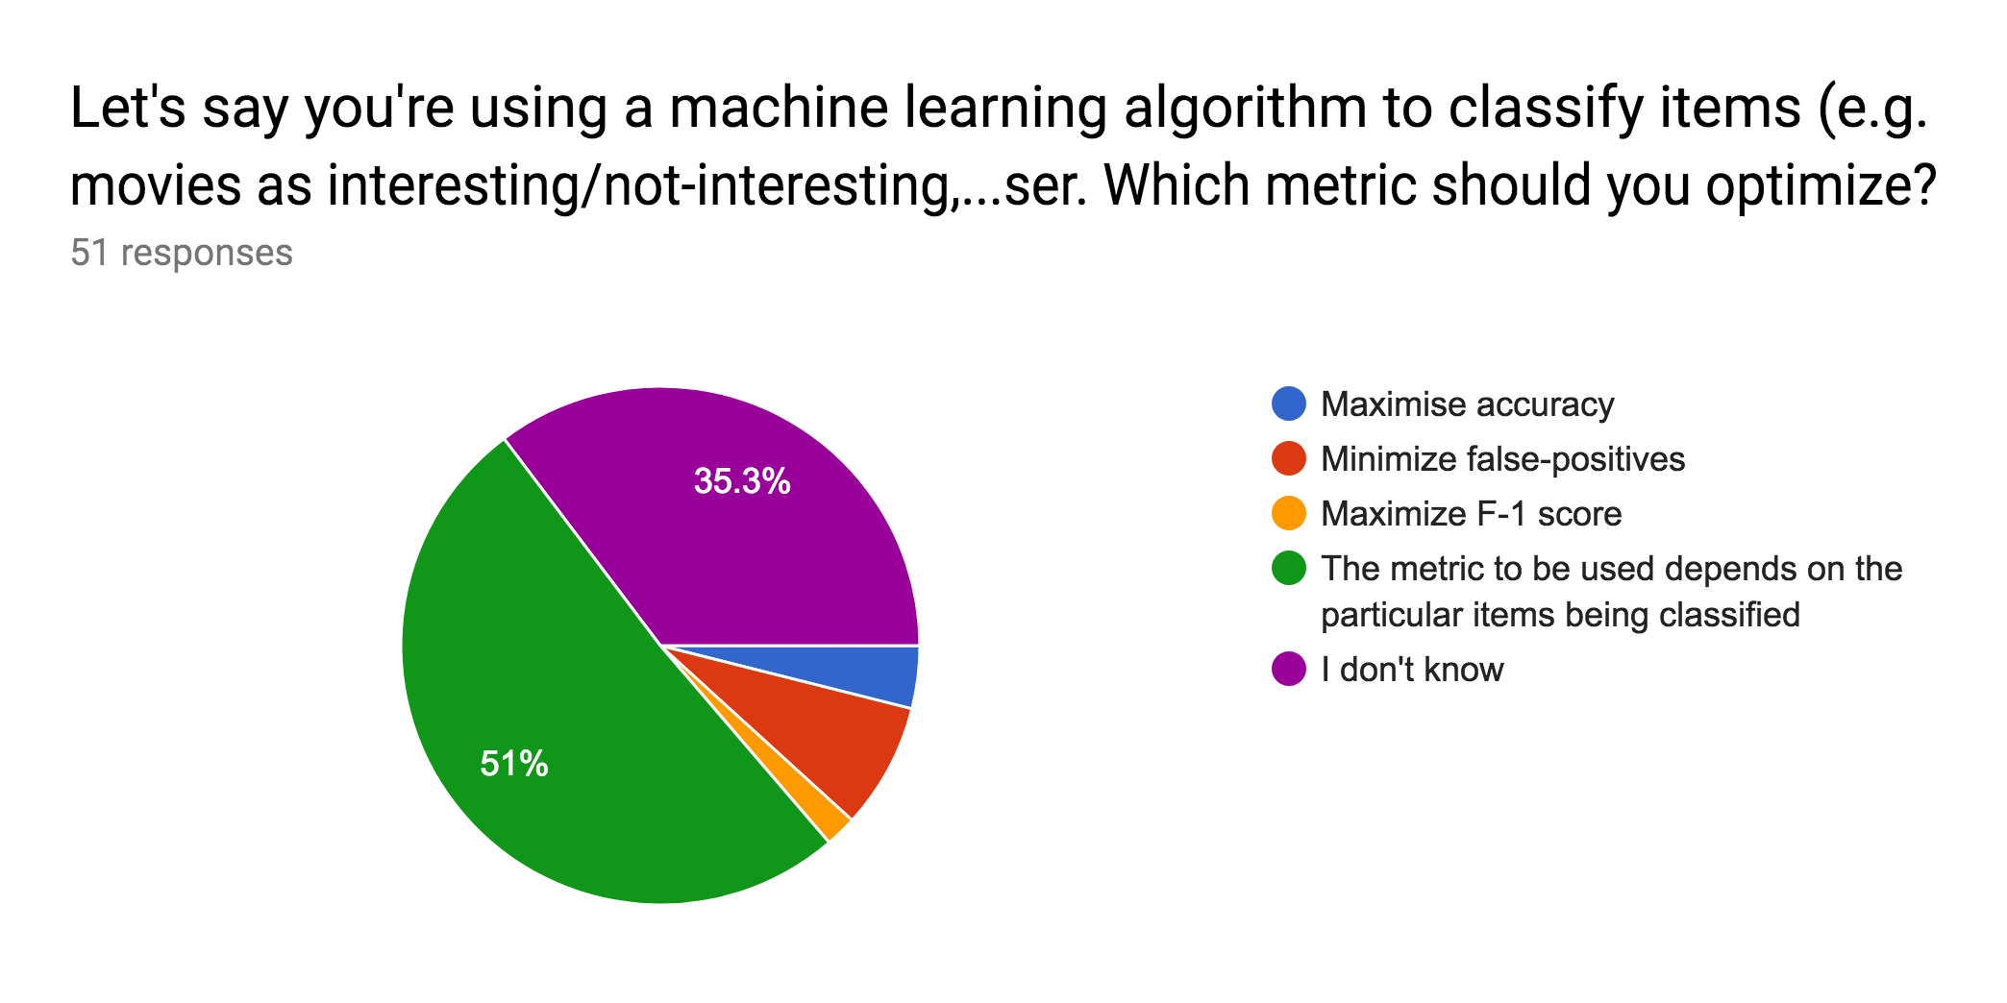
Flashback: what have we learned?

Slide 12
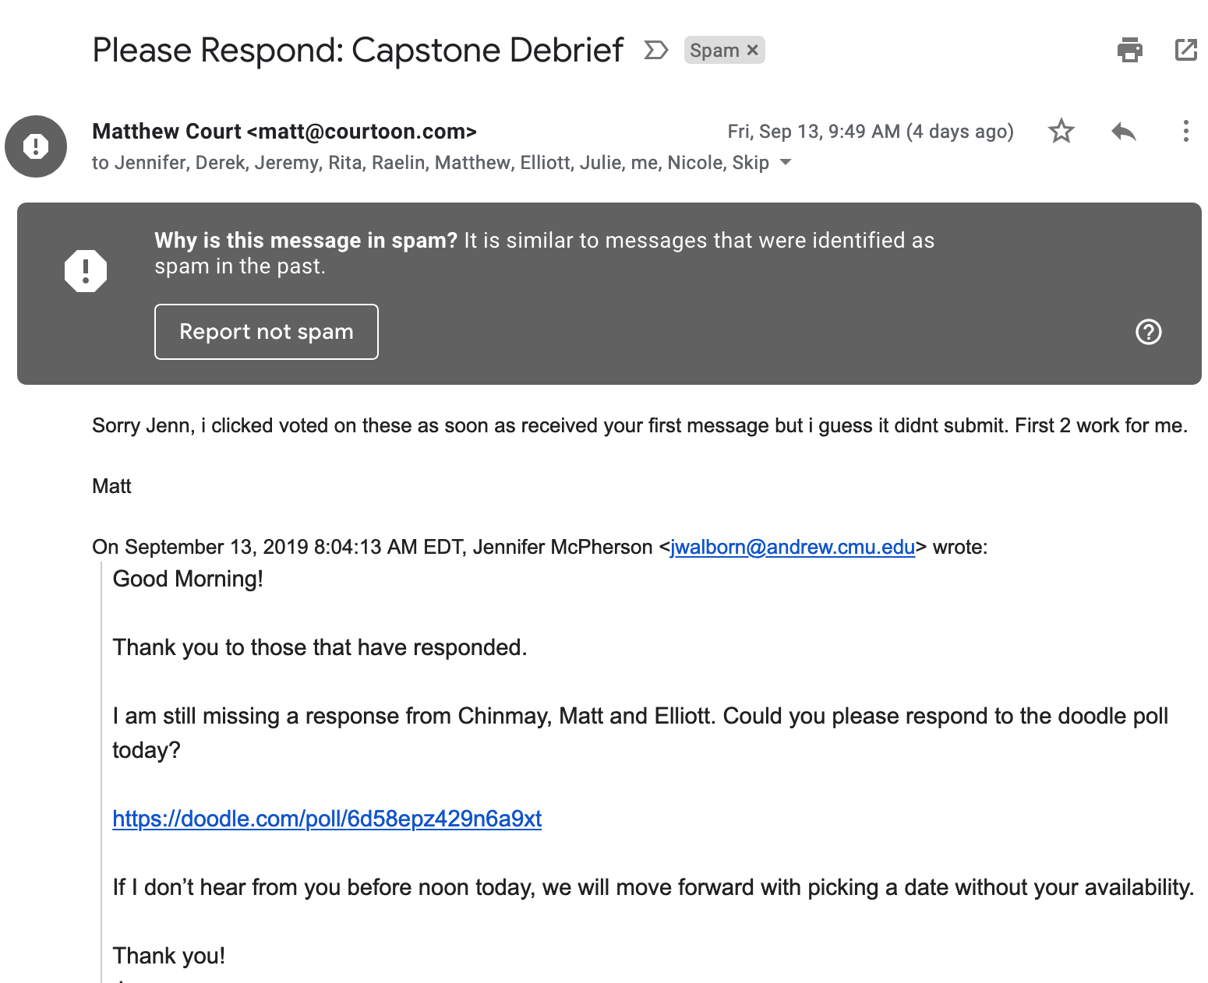
Activity: Is this an error?

Slide 13
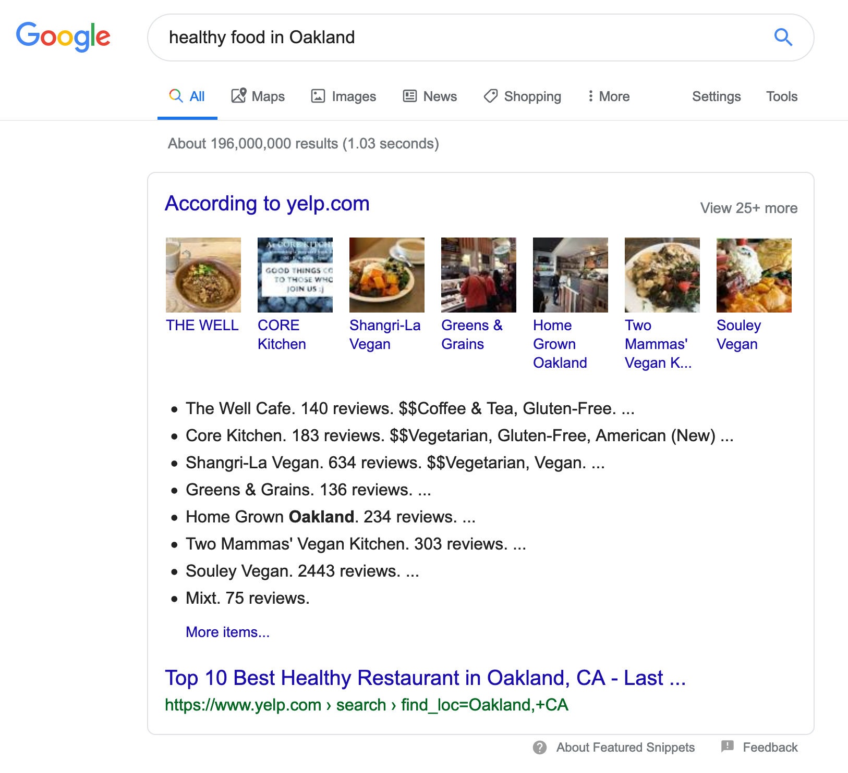
Activity: Is this an error?

Slide 14
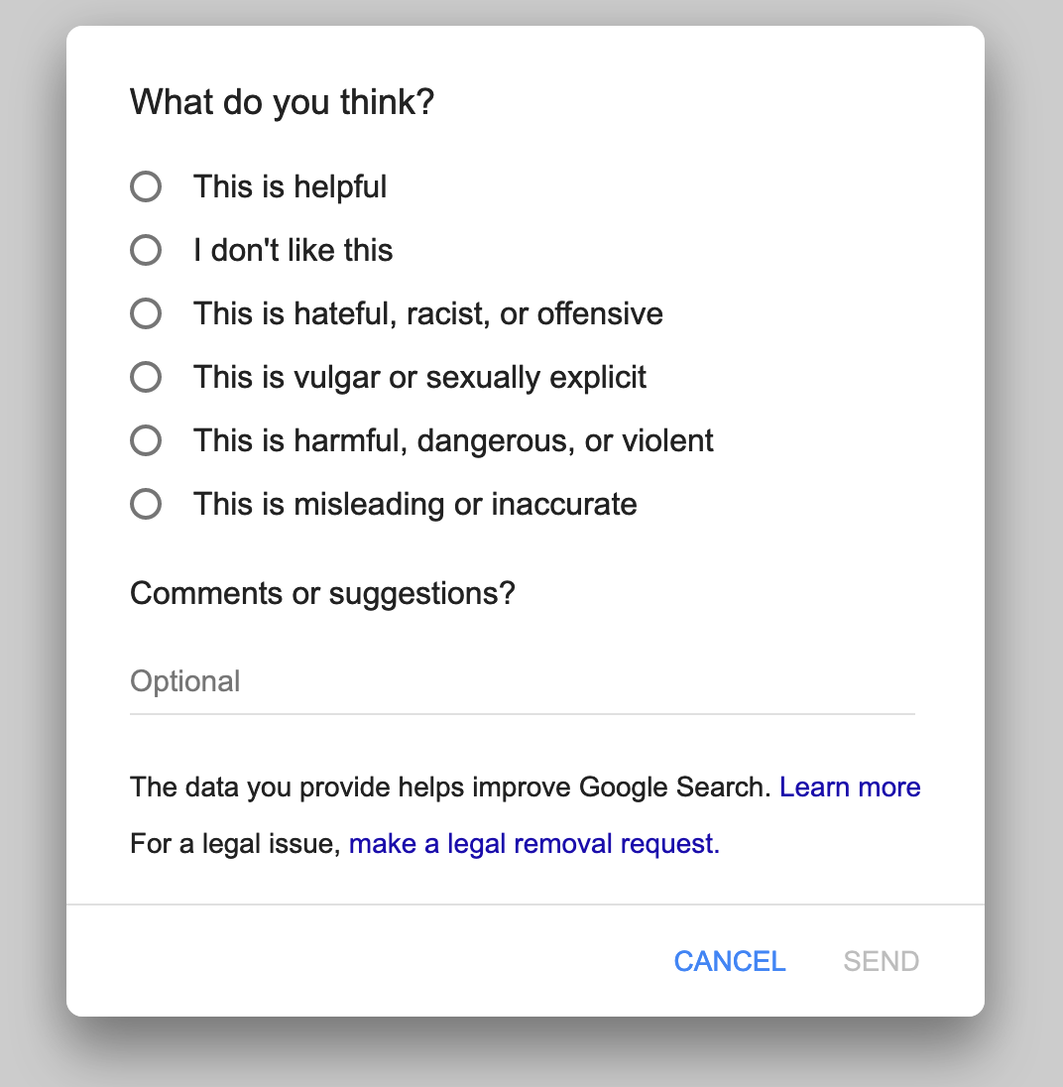
Activity: Is this an error?

Slide 15
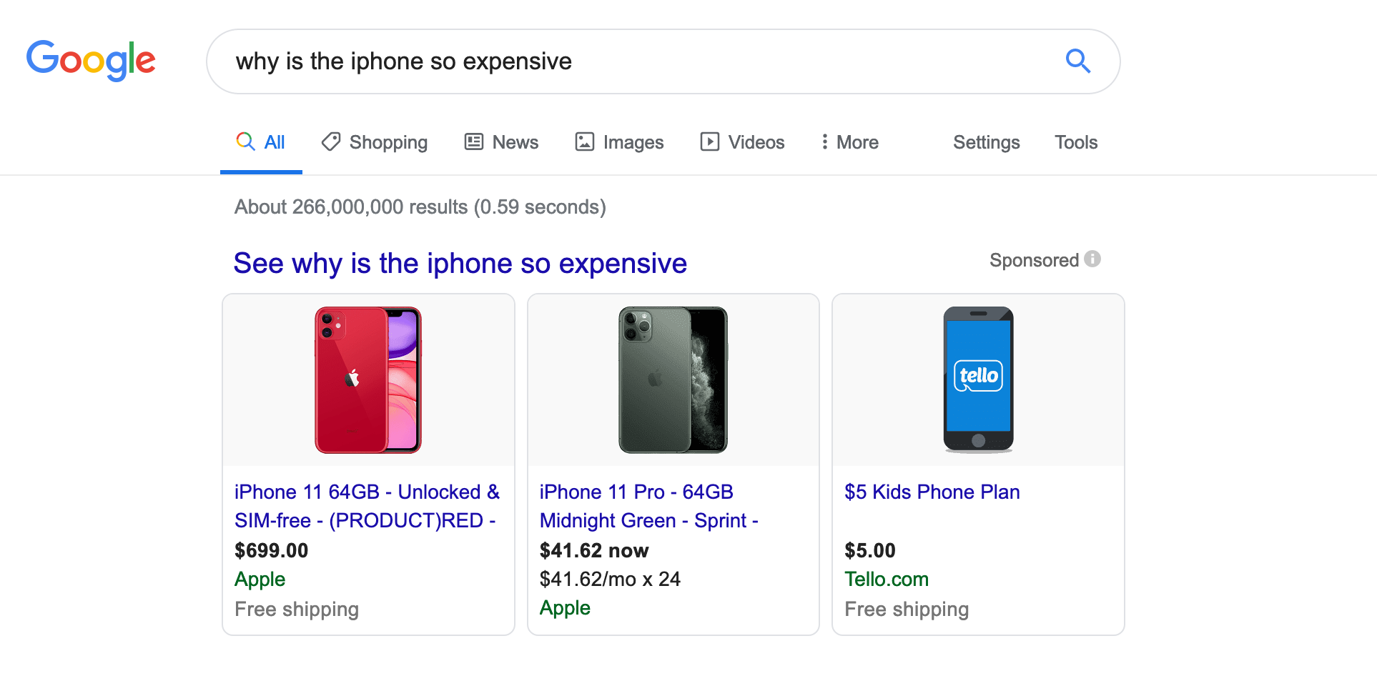
Activity: Is this an error?

Slide 16
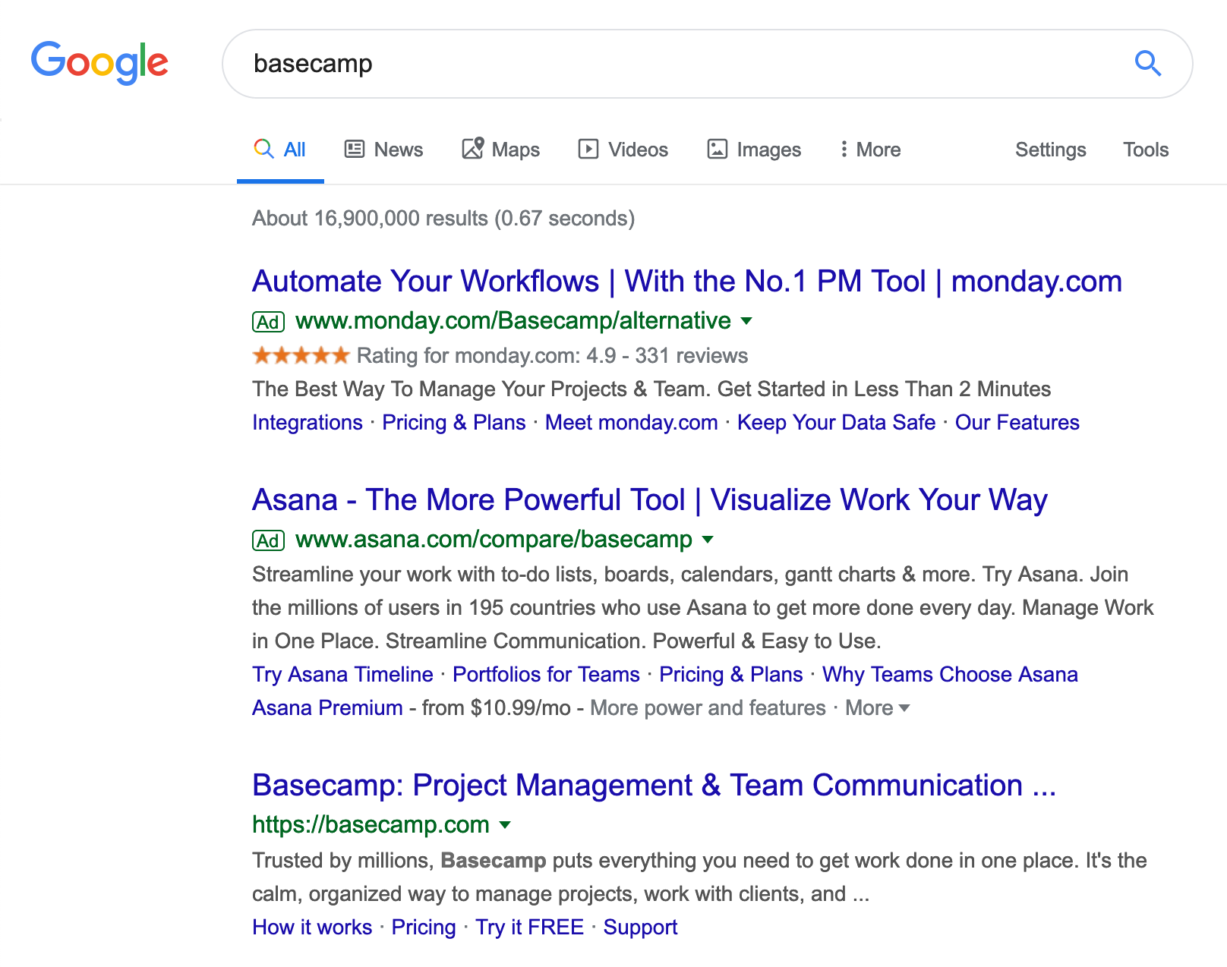
Activity: Is this an error?

Slide 17
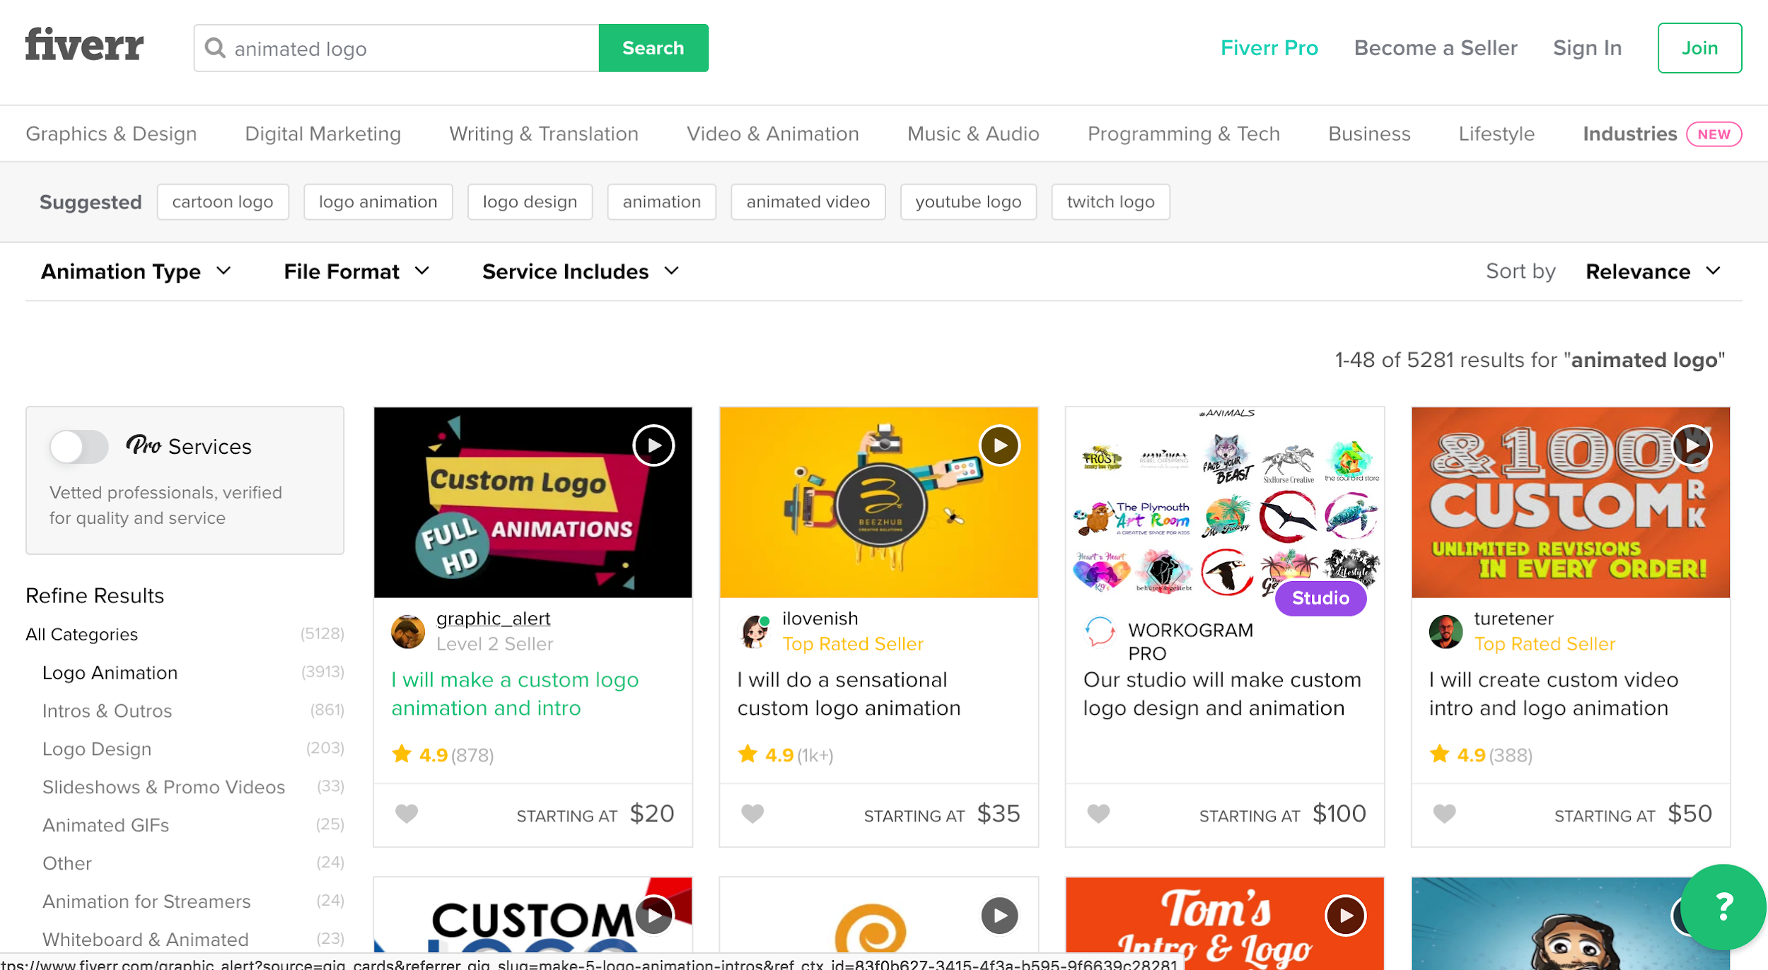
Background: Fiverr lets you hire someone for a quick job

Slide 18
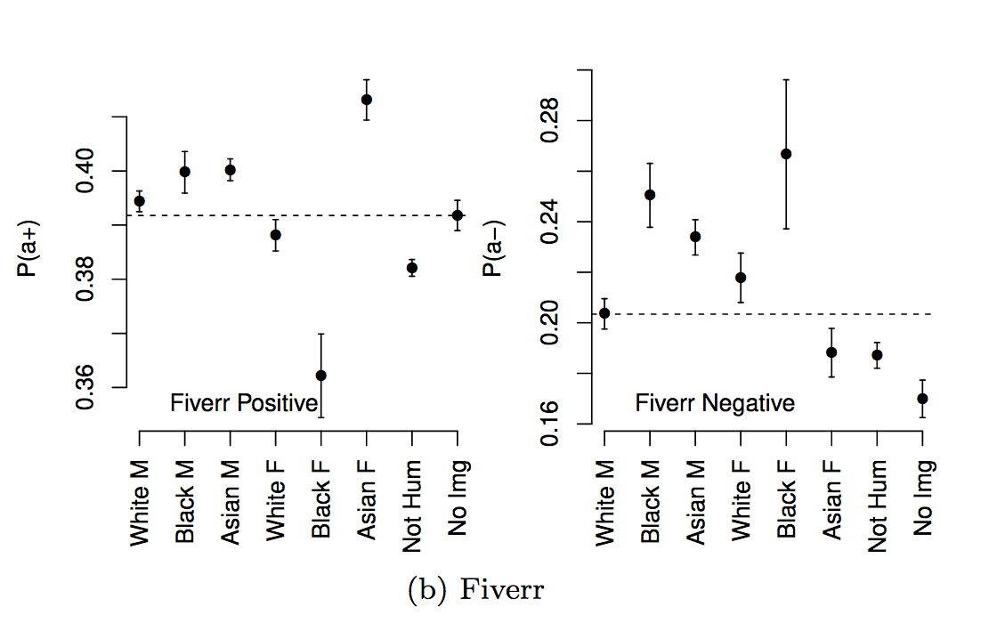
Activity: Is this an error?
People have biases.
On Fiverr, people have more positive or negative reviews, based on their gender and race.
See https://dl.acm.org/citation.cfm?id=2998327

Slide 19
Activity: Is this an error?
People have biases.
On Fiverr, people have more positive or negative reviews, based on their gender and race.

Slide 20
Takeaways:
what is an error depends on your goals.
The service designer may have different goals than the user.
AI can amplify human stereotypes

Slide 21
Activity 3: we failed… now what? (Social AI applications)
You see a photo of your ex on Facebook.
Is this an error?

Slide 22
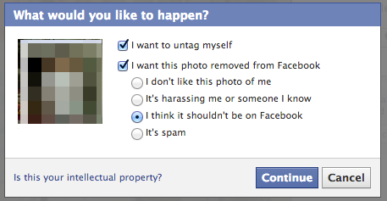
Activity: we failed… now what? (Social AI applications)
You see a photo of your ex on Facebook.
Is this an error?

Slide 23
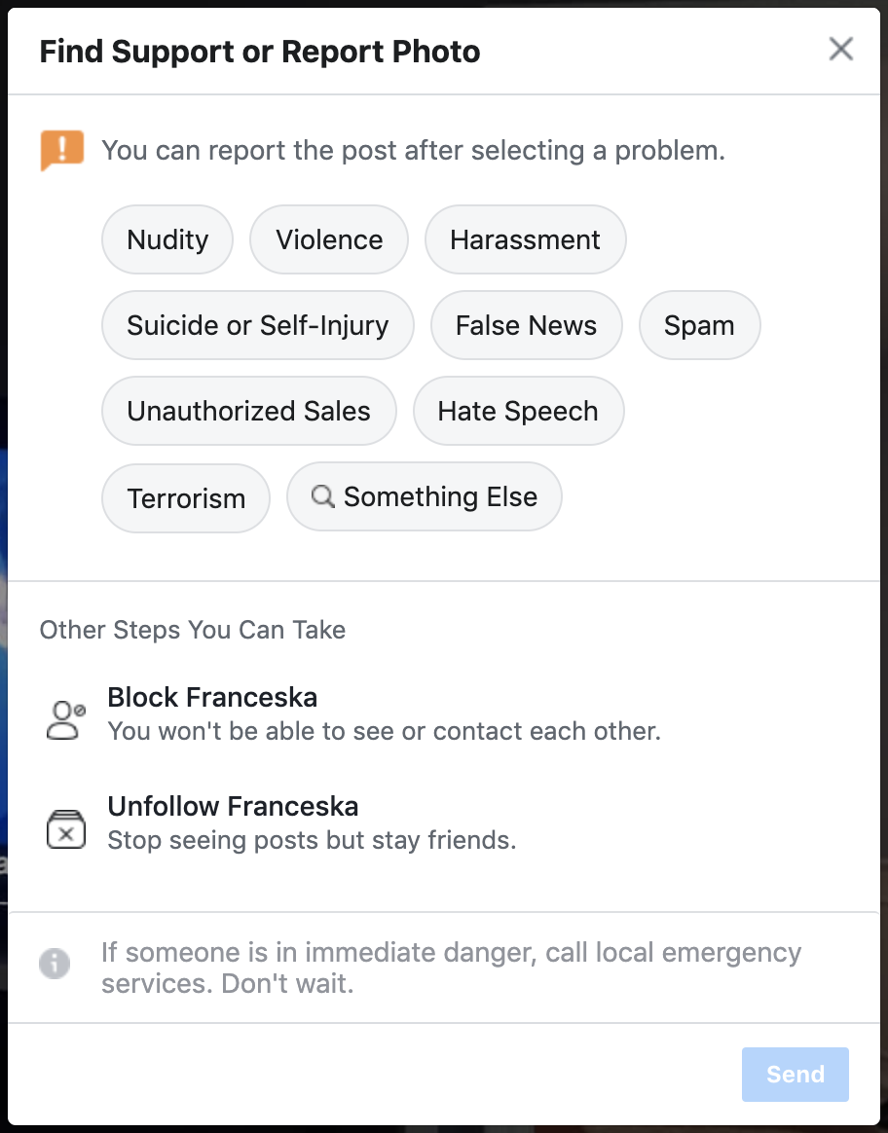
Activity: we failed… now what? (Social AI applications)
What does this do well?
What does it do poorly?

Slide 24
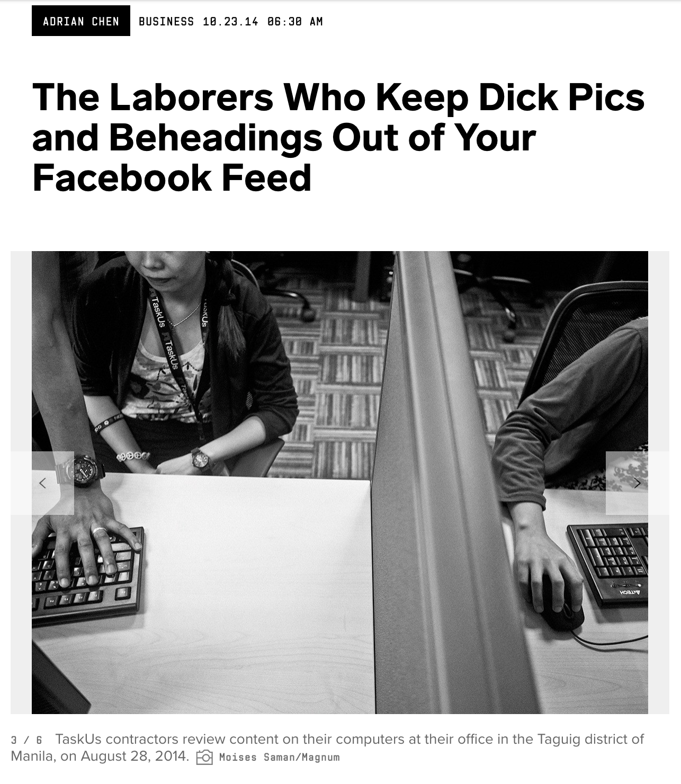
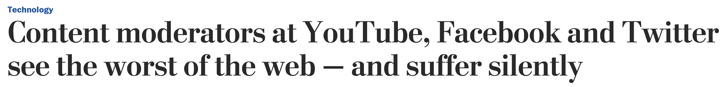
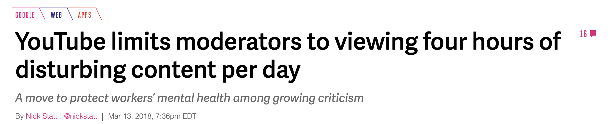
Activity: we failed… now what? (Social AI applications)
Notes:
Articles from Wired https://www.wired.com/2014/10/content-moderation/
Verge https://www.theverge.com/2018/3/13/17117554/youtube-content-moderators-limit-four-hours-sxsw
https://www.washingtonpost.com/technology/2019/07/25/social-media-companies-are-outsourcing-their-dirty-work-philippines-generation-workers-is-paying-price/?noredirect=on

Slide 25
User centered design and its discontents
The problem:
You sometimes have to do things that users don’t like (show them ads, make an error, etc). If you’re user-centered, this is against what you seek to achieve
Corollary:
If you’re user-centered, you tend to miss out on opportunities, because you are unable/unwilling to make errors, or not give users what they want.
What can we do?

Slide 26
Service design
Services are systemic, meaning that they are designed with multiple stakeholders in mind, rather than one user
Service considers value in exchange as a key portion of a service experience.
Service design encompasses economic models as a core part of its design process

Slide 27
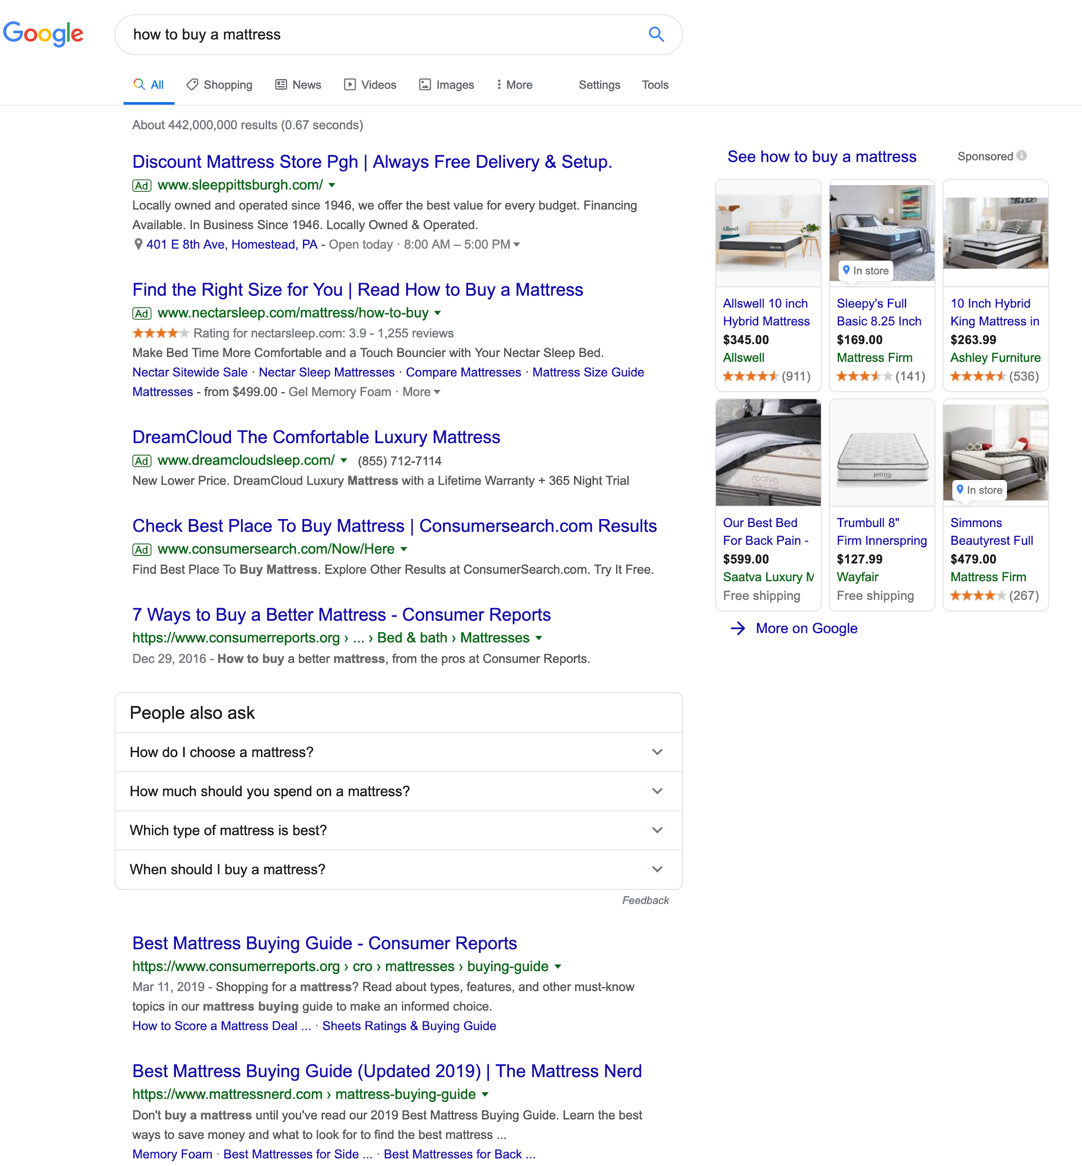
Contrasting the results: service design considers more stakeholders
User-centered design: user as stakeholder
Service design - multiple stakeholders

Slide 28
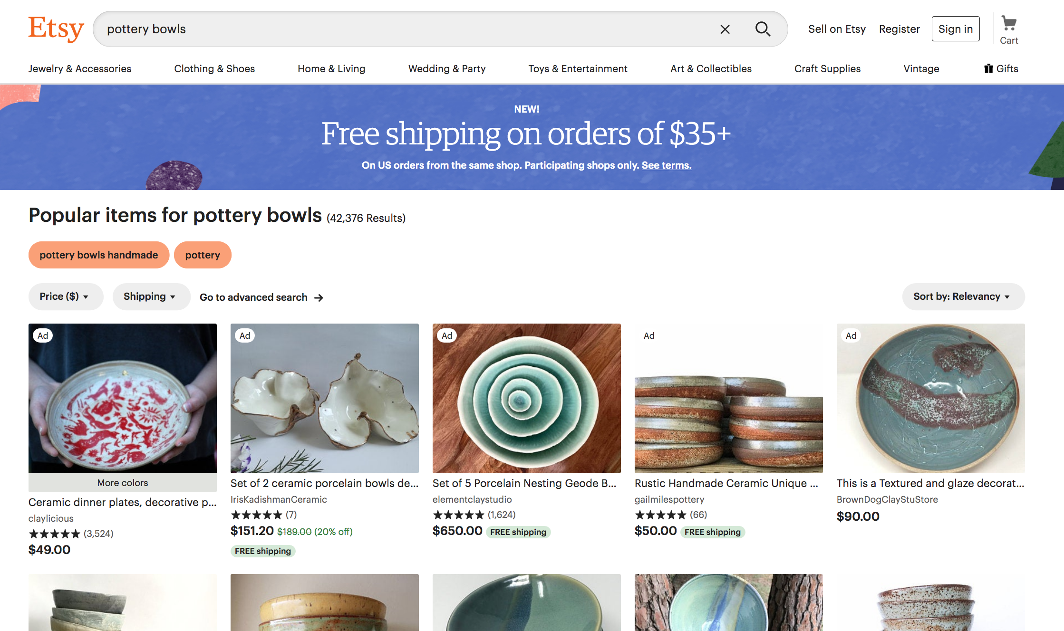
Designing for multiple stakeholders

Slide 29
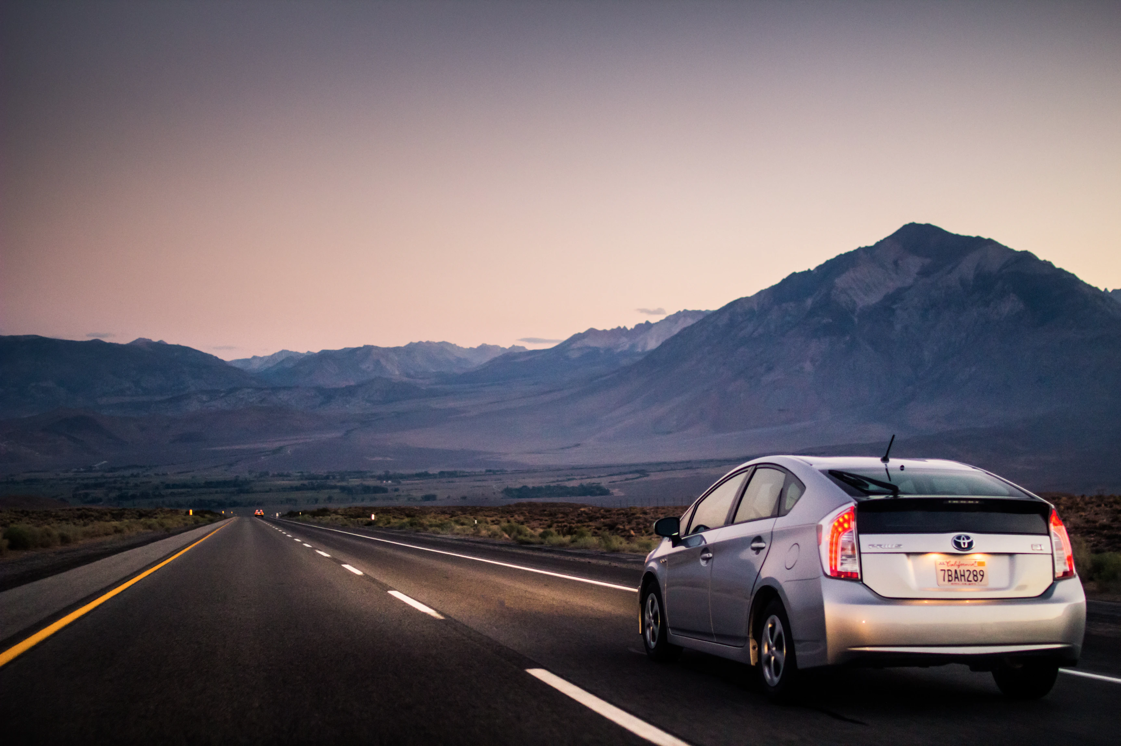

Contrasting the results: service design considers economics
User-centered design: what does the user want?
Service design: economic considerations (parking, road width)

Slide 30
Service design considers flows of value
Here, there are two flows of value:
Transit tells you where to change busses
You tell Transit where you are (so it can improve arrival time predictions.)
“Like a helpful personal robot, GO thinks about your journey so you don’t have to.”

Slide 31
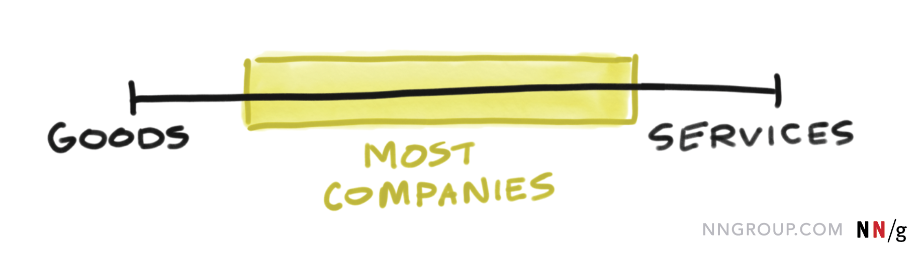
Getting to the specifics of service design - 1
This is especially true for AI applications; where you want to collect data etc.

Slide 32
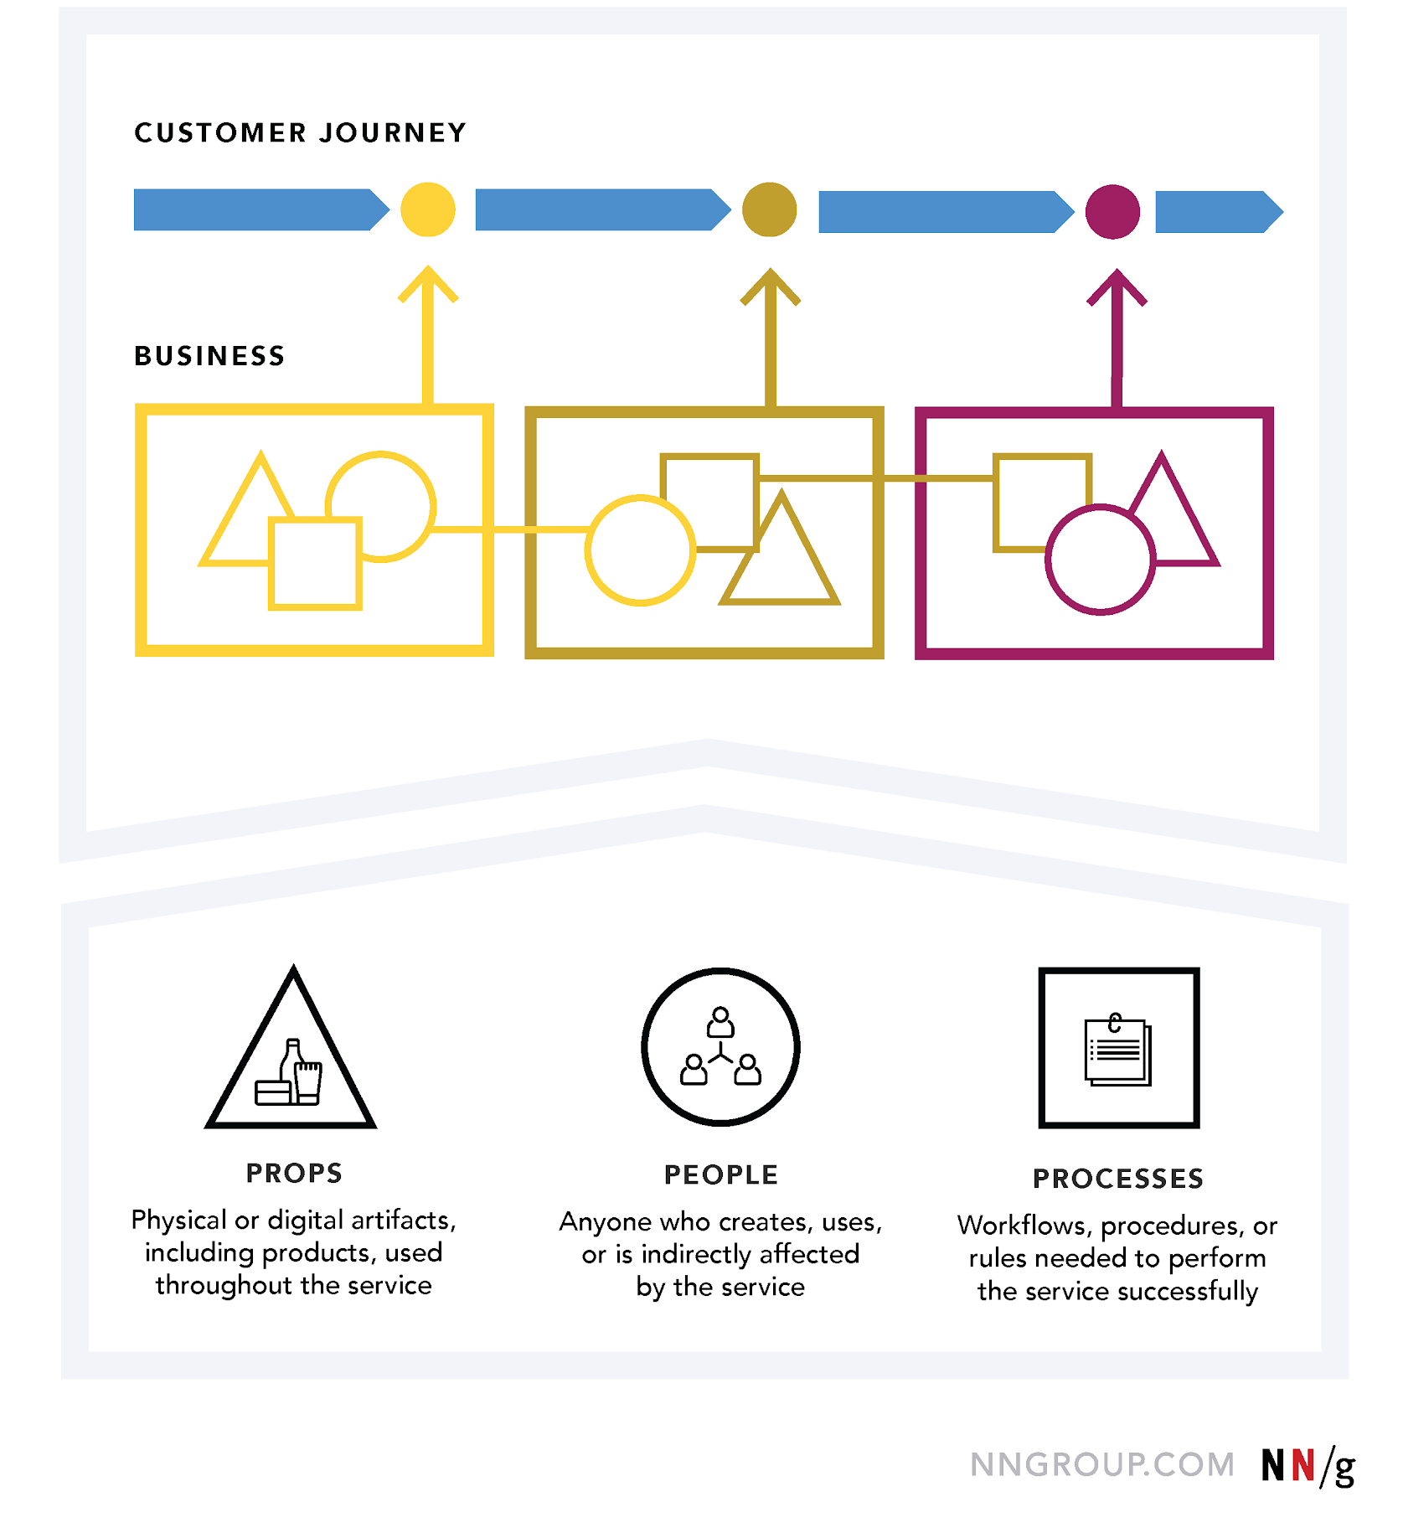
Can be an AI infused system

Slide 33
Can be an AI infused system

Slide 34
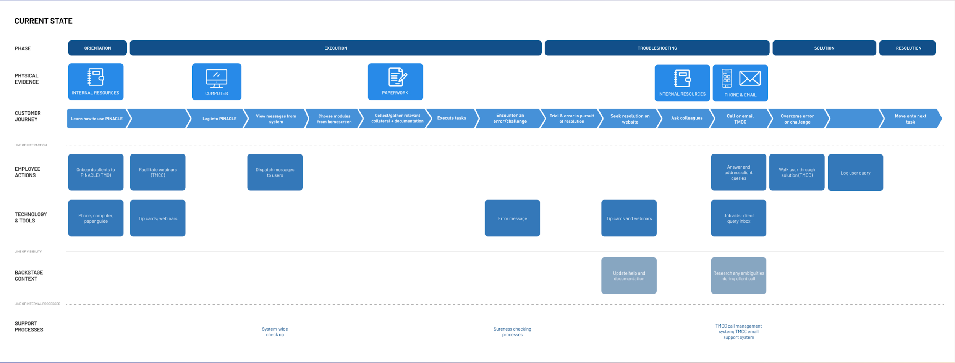
How do you start with service design? Service blueprint

Slide 35
Ideating for AI
Service need
AI capability in other domain
Human mental models of service

Slide 36
Micro-ideation: recommend courses to CMU undergrads
Who are the stakeholders?
What are the current value flows?
What are our AI capabilities?
---
Who are the potential stakeholders?
What are the potential value flows?
What are our AI capabilities to meet these value flows/stakeholders?

Slide 38
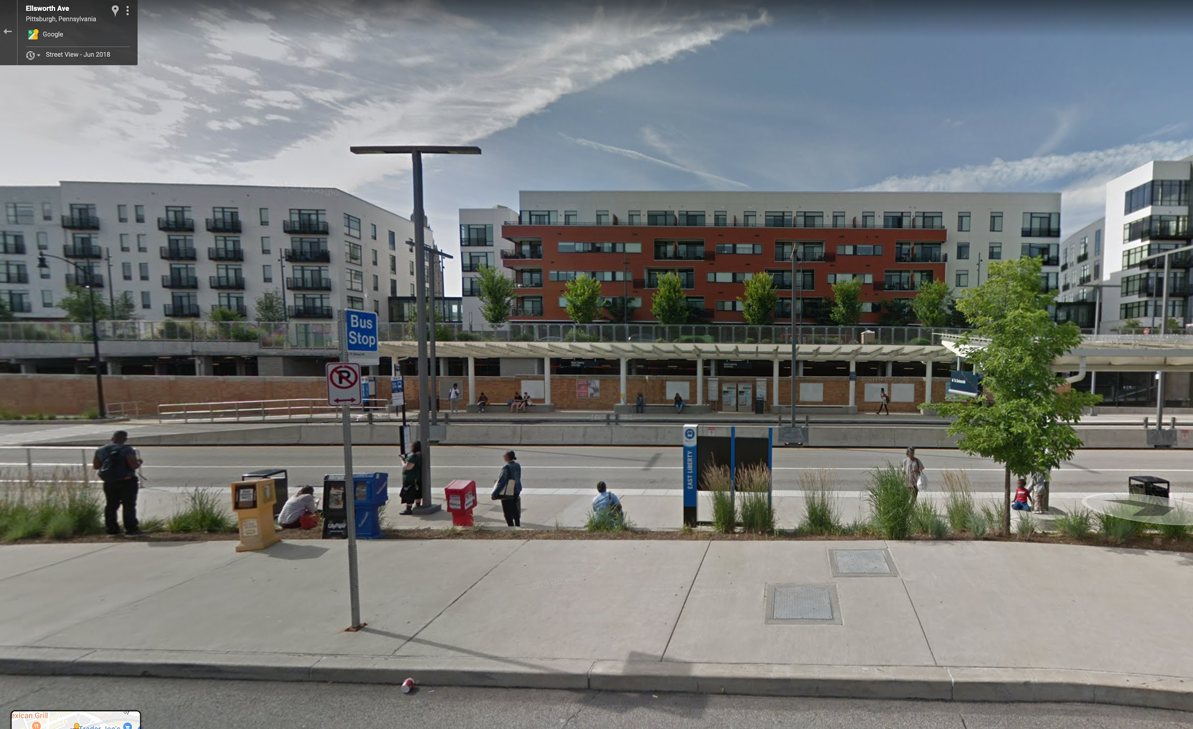
Activity 2: we failed… now what? (Personal AI applications)
Last week, I used Transit. It told me to change busses at the East Liberty Busway station. Problem? You can’t walk across the street to catch a bus (must climb stairs).
I missed the bus.
Is this an error?
“Like a helpful personal robot, GO thinks about your journey so you don’t have to.”

Slide 39
Activity: we failed… now what? (Personal AI applications)
What can we improve about this failure case during:
Onboarding/introduction to system
During use?
On failure?
For preventing future failure?
“Like a helpful personal robot, GO thinks about your journey so you don’t have to.”

Slide 40
Activity: we failed… now what? (Personal AI applications)
Should you use AI to detect failure?
If not, what should you use instead?
If yes, what conditions?
“Like a helpful personal robot, GO thinks about your journey so you don’t have to.”

